Slide 1
Shrinkage Methods
Name: Vaibhav Bichave
Roll No: 43209
Subject: Machine Learning
Subject Code: 410301

Slide 2
Why shrinkage method ?
When overﬁtting occurs where model gives good accuracy on the training set and low accuracy on test set in spite of adding all the available dependent features.
Shrinkage methods are also known as regularization, and when they come in play, these methods apply a penalty term to the Loss function used in the model, which minimizes the loss function is equal to maximizing the accuracy.

Slide 3
What does shrinking do ?
Shrinking the coefﬁcient estimates signiﬁcantly reduces their variance. When we perform shrinking, we essentially bring the coefﬁcient estimates closer to 0.
The need for shrinkage method arises due to the issues of underﬁtting or overﬁtting the data. When we want to minimize the mean error (Mean Squared Error (MSE) in case of Linear Regression), we need to optimize the bias-variance trade-off.

Slide 4
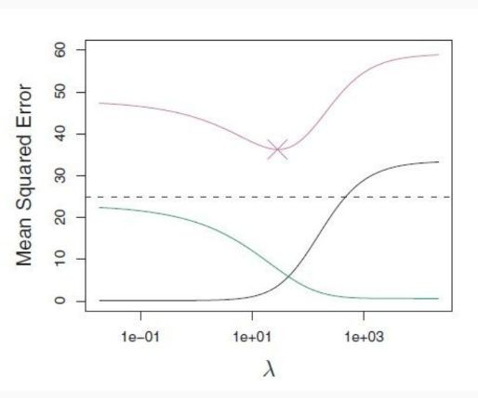
What is this bias-variance trade oﬀ ?
The bias-variance trade-off indicates the level of underﬁtting or overﬁtting of the data with respect to the Linear Regression model applied to it.
A high bias-low variance means the model is underﬁtted and a low bias-high variance means that the model is overﬁtted.
We need to trade-off between bias and variance to achieve the perfect combination for the minimum Mean Squared Error as shown by the graph below.

Slide 5
Uses of shrinking methods
The best known shrinking methods are Ridge Regression and Lasso Regression which are often used in place of Linear Regression.

Slide 6


Ridge Regression
The ridge regression estimates the regression parameters B minimizing the RSS with a penalty term (on the sum of squares of the coefﬁcients). Its formula is given as,
where, is the penalty term.
$$RSS+λ\sum_{j=1}^{P}{B_{j}^{2}}$$
$$λ\sum_{j=1}^{P}{B_{j}^{2}}$$

Slide 7
So if lambda is big, the sum of squares of the coefﬁcients must be small and will shrink the coefﬁcients towards zero. And as lambda gets very big, the coefﬁcients will all be zero.
The algorithm will try to make the RSS small but at the same time, the penalty term is going to push it in the other direction penalizing coefﬁcients which get too large. The more non-zero a coefﬁcient is, the larger the penalty term is. The larger the coefﬁcients are, the bigger the penalty price is.
It's basically ﬁt versus the size of the coefﬁcients. That penalty is called a shrinkage penalty because it's going to encourage the parameters to be shrunk toward 0.

Slide 8
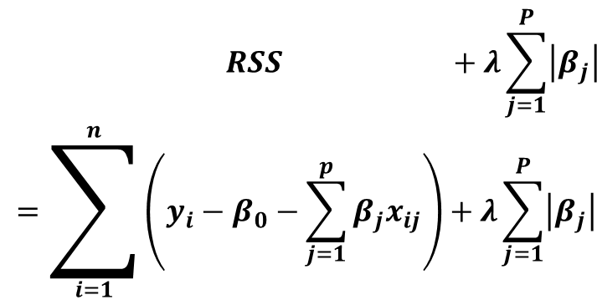
Lasso Regression
The lasso (as ridge regression) estimates the regression parameters (lasso coeffecients minimizing the RSS with a penalty term.
$$\begin{matrix} RSS +λ\sum_{j=1}^{P}{\left|β_{j}\right|} \\ =\sum_{i=1}^{n}{\left(y_{i}−β_{0}−\sum_{j=1}^{p}{β_{j}x_{ij}}\right)}+λ\sum_{j=1}^{P}{\left|β_{j}\right|}\end{matrix}$$

Slide 9
The algorithm will try to make the RSS small but at the same time, the penalty term is going to push it in the other direction penalizing coefﬁcients which get too large. The more non-zero a coefﬁcient is, the larger the penalty term is. The larger the coefﬁcients are, the bigger the penalty price is.
It's basically ﬁt versus the size of the coefﬁcients.
That penalty is called a shrinkage penalty because it's going to encourage the parameters to be shrunk toward 0.

Slide 10
Ridge regression VS Lasso Regression
There is no rule that means that you should always use one technique over another. It depends on the situation.
The lasso encourages sparse model, whereas with ridge we get a dense model. Then if the true model is quite dense, we could expect to do better with ridge. If the true model is quite sparse, we could expect to do better with the lasso.
Because we don't know the true model, it's typical to apply both methods and use cross-validation to determine the best model.

Slide 11
Thank you!

